Slide 1
Professor Dimitrios Melissourgos
CIS 337 - NETWORK SYSTEMS MANAGEMENT
Midterm 1 Answers

Slide 2
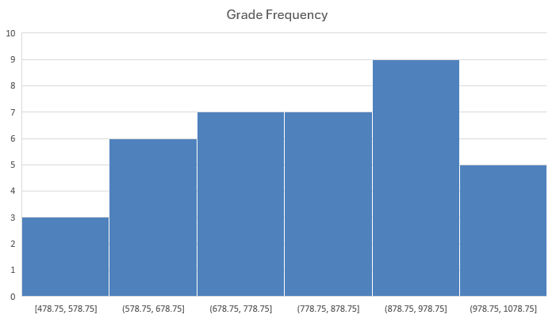
37 students in 2 sections 68 questions 52 minutes average submission time 46 seconds per question average 70% average score (812 out of 1160) 833 out of 1160 median score

Slide 3
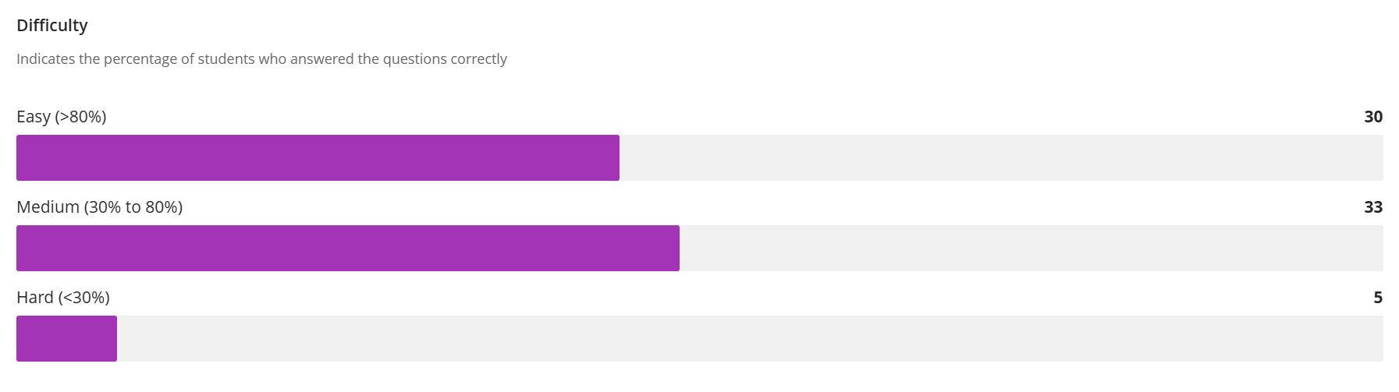
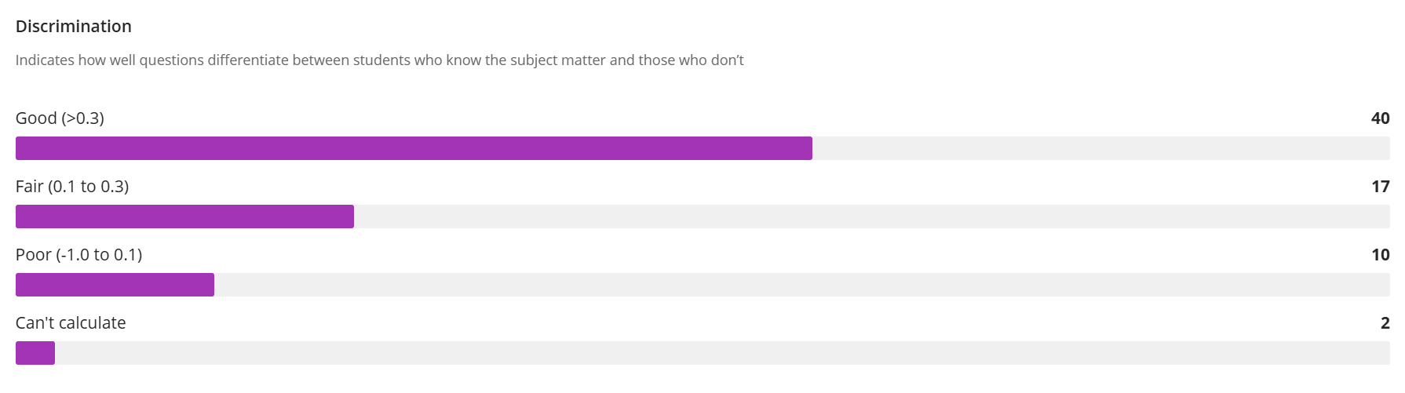

Slide 4
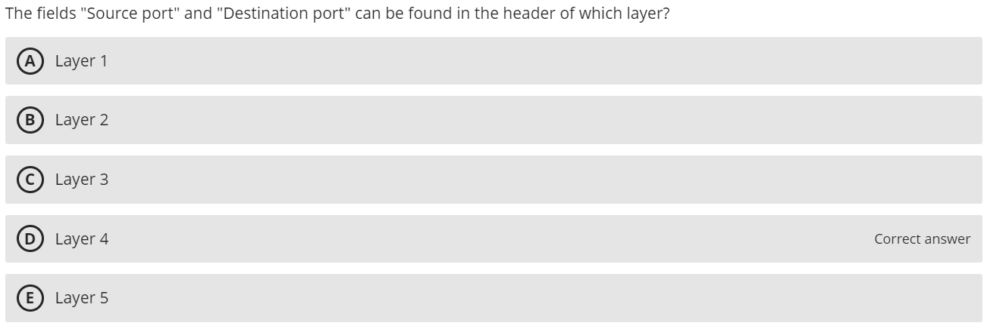
60.41% Correct

Slide 5
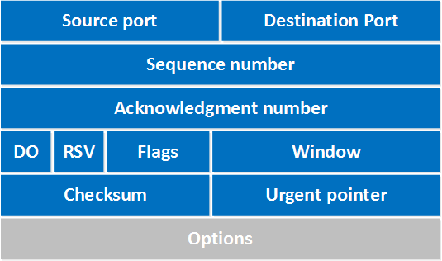
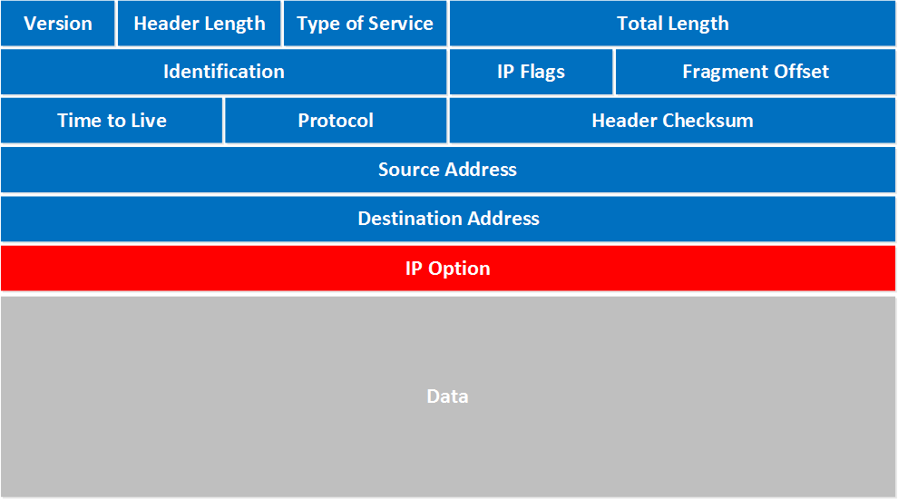
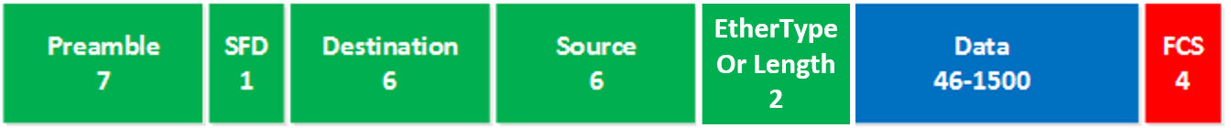
L4, L3, L2 Headers
Layer 4
Transport Layer
TCP
Port Numbers
Layer 3
Network Layer
IP
IP Addresses
Layer 2
Data Link Layer
Ethernet
MAC Addresses
Notes:
Source: NetworkLessons.com

Slide 6
Encapsulation and Headers
L2 Frame – Gets converted to binary
L2 Frame’s Data Field – L3 Packet
L3 Packet’s Data Field – L4 Segment
L4 Segment’s Data Field – L5 Packet
[HTTP [HTML [“Congratulations! You’ve…”]]]

Slide 7
Transport Layer Protocols
Transmission Control Protocol (TCP)
Most common transport layer protocol
PDU called a segment
Used for reliable transmission of data
160 - 192 bits (20 -24 bytes) of overhead
Options field is not required
Source Port
(16 bits)
Destination Port
(16 bits)
Sequence Number
(32 bits)
ACK number
(32 bits)
Header Length
(4 bits)
Unused
(6 bits)
Flags
(6 bits)
Flow Control
(16 bits)
CRC-16
(16 bits)
Urgent Pointer
(16 bits)
Options
(32 bits)
User Data
(varies)

Slide 8
Transport Layer Protocols
User Datagram Protocol (UDP)
Operates at the transport layer
PDU called a datagram
Used in time-sensitive situations, for control messages, or when reliability is handled by the application layer
32-64 bits (4-8 bytes) of overhead
Source port is optional in IPv4 and IPv6, Checksum is optional in IPv4
Source Port
(16 bits)
Destination Port
(16 bits)
Length
(16 bits)
Checksum
(16 bits)
User Data
(varies)

Slide 9
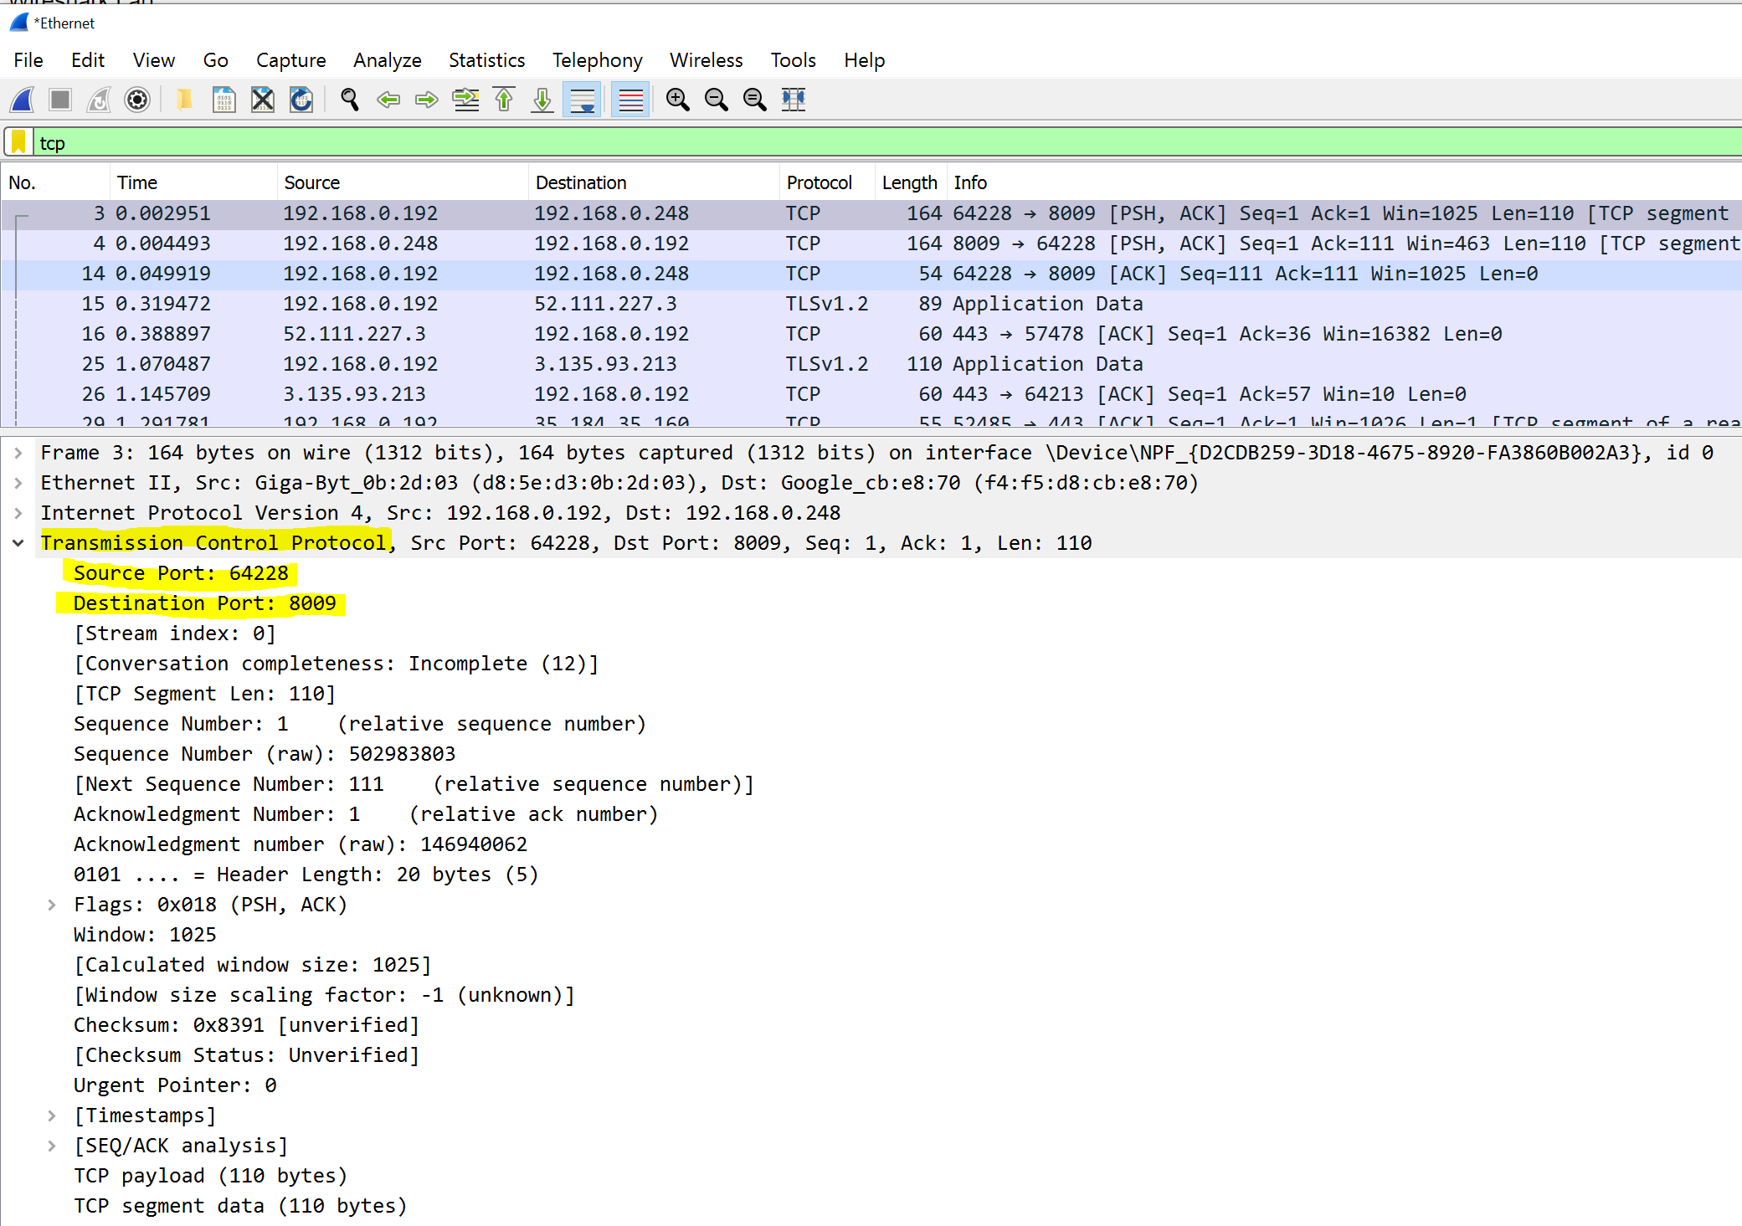

Slide 10
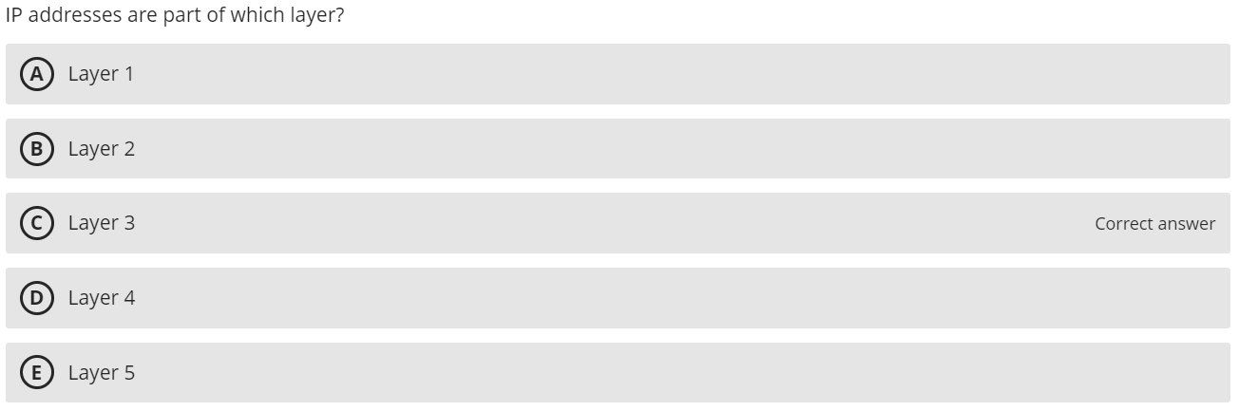
92.09% Correct

Slide 11
L4, L3, L2 Headers
Layer 4
Transport Layer
TCP
Port Numbers
Layer 3
Network Layer
IP
IP Addresses
Layer 2
Data Link Layer
Ethernet
MAC Addresses
Notes:
Source: NetworkLessons.com

Slide 12
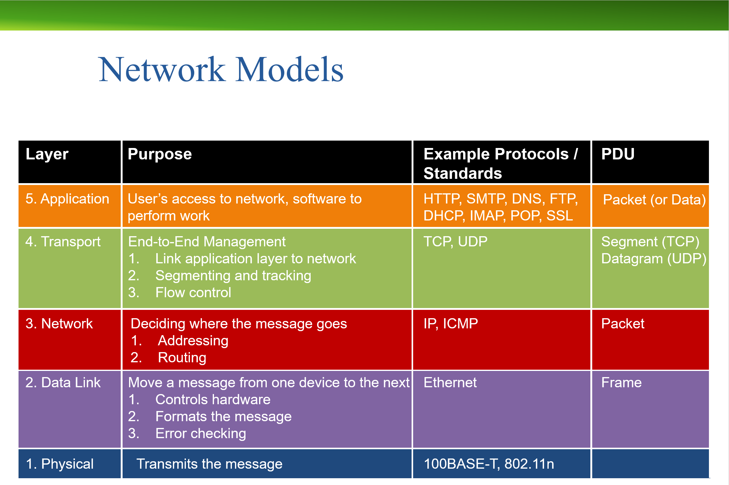

Slide 13
 | Sender | PDU | Receiver
Application |  | Packet
Transport |  | Segment
Network |  | Packet
Data Link |  | Frame
Physical
HTTP
HTTP
Request
Request
TCP
TCP
TCP
HTTP
HTTP
HTTP
Request
Request
Request
IP
IP
IP
TCP
TCP
HTTP
HTTP
Request
Request
Ethernet
Ethernet
Ethernet
IP
IP
TCP
TCP
HTTP
HTTP
Request
Request

Slide 14
Network Layer Protocols
Internet Protocol (IP)
IP version 4 (IPv4)
Most common version of IP used
32-bit addresses (2³² or ~4.29 billion possible)
Exhaustion of address space
IP version 6 (IPv6)
128-bit addresses (2¹²⁸ or ~3.4 × 10³⁸ possible)
Slowly being adopted due to IPv4 exhaustion

Slide 15
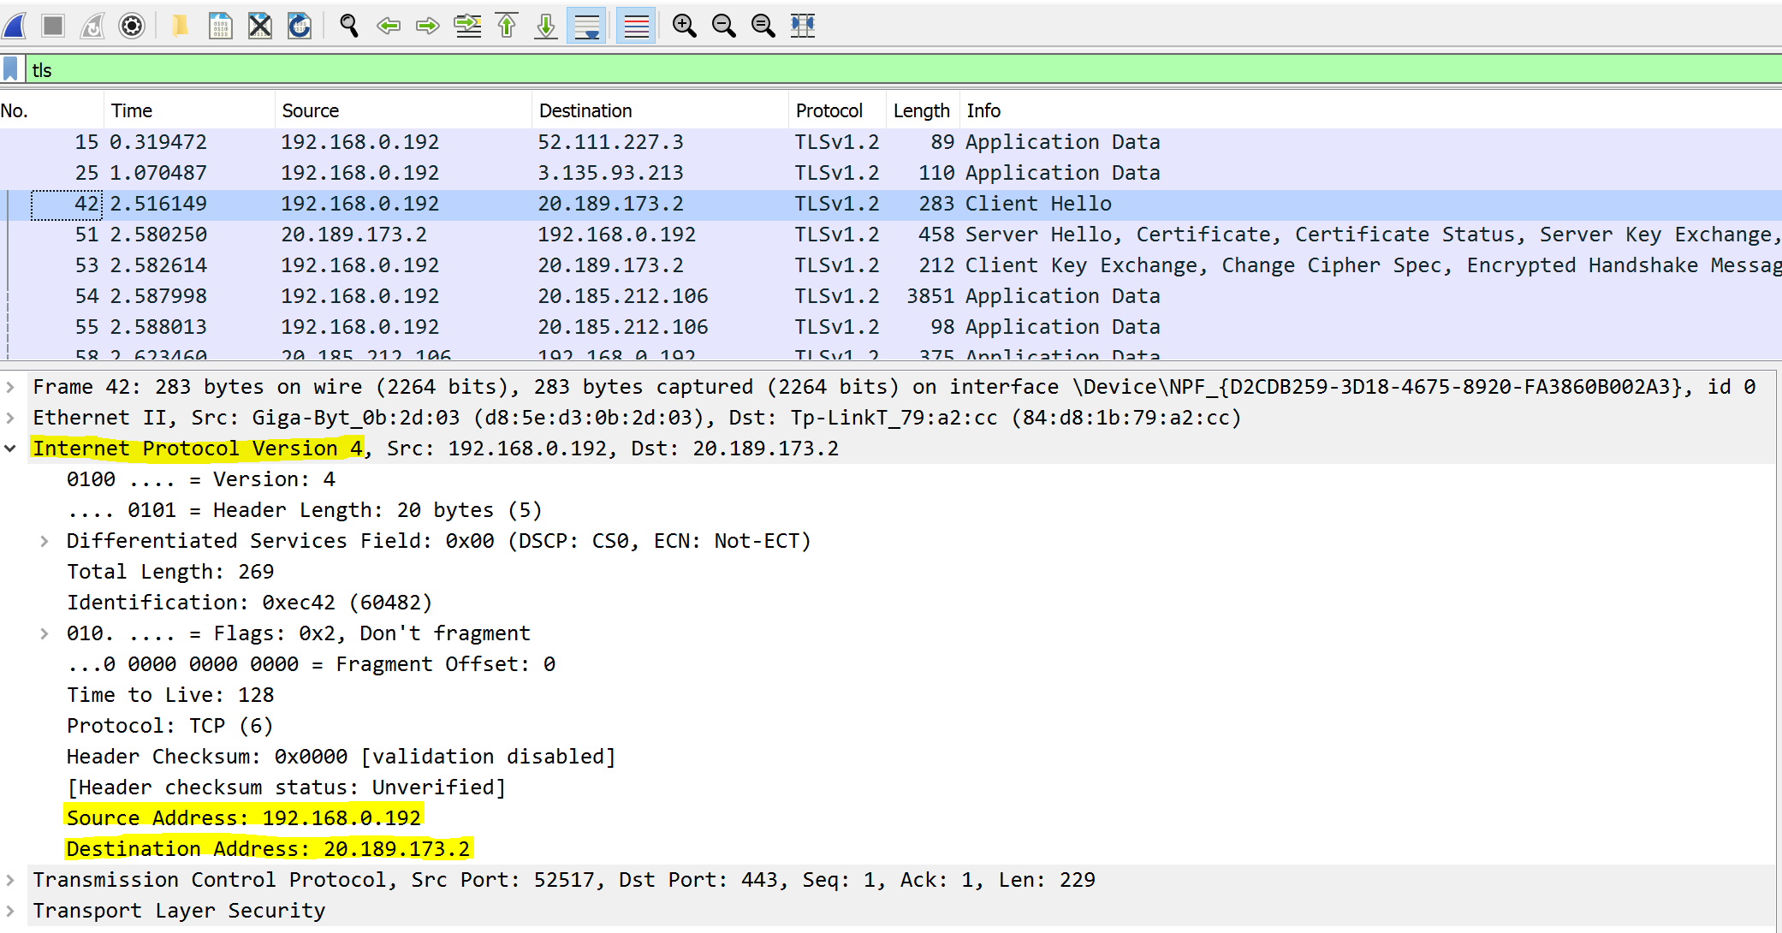

Slide 16
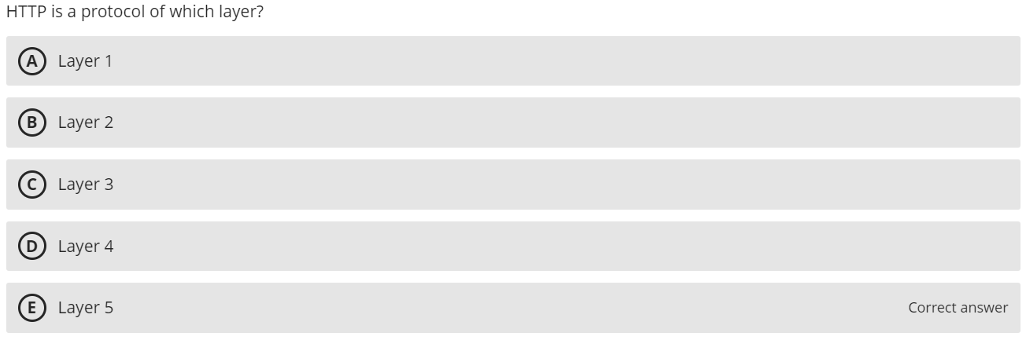
87.74% Correct

Slide 17
Business Data Communications & Networking
Chapter 2
Application Layer

Slide 18
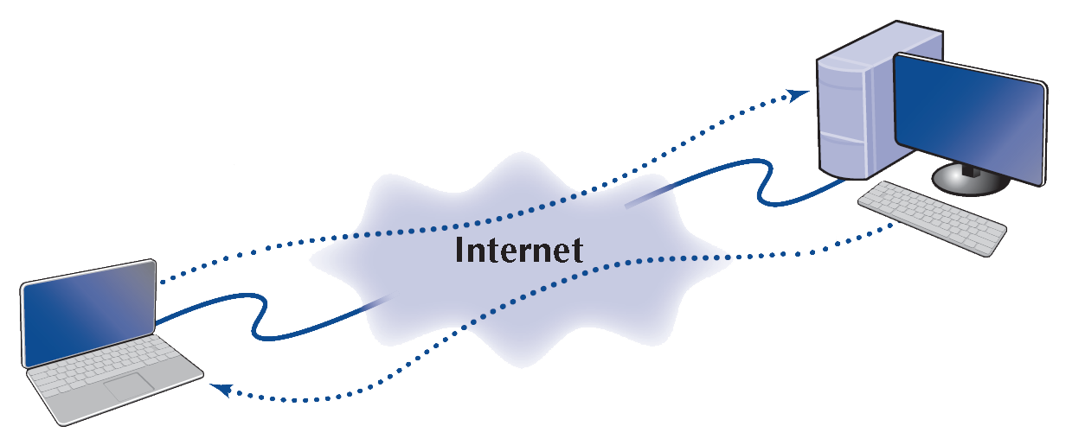
The Web
Hypertext Transfer Protocol (HTTP)
Standard protocol for communication between a web browser and a web server
Client computer with Web browser software
HTTP Response
Web Server
HTTP Request

Slide 19
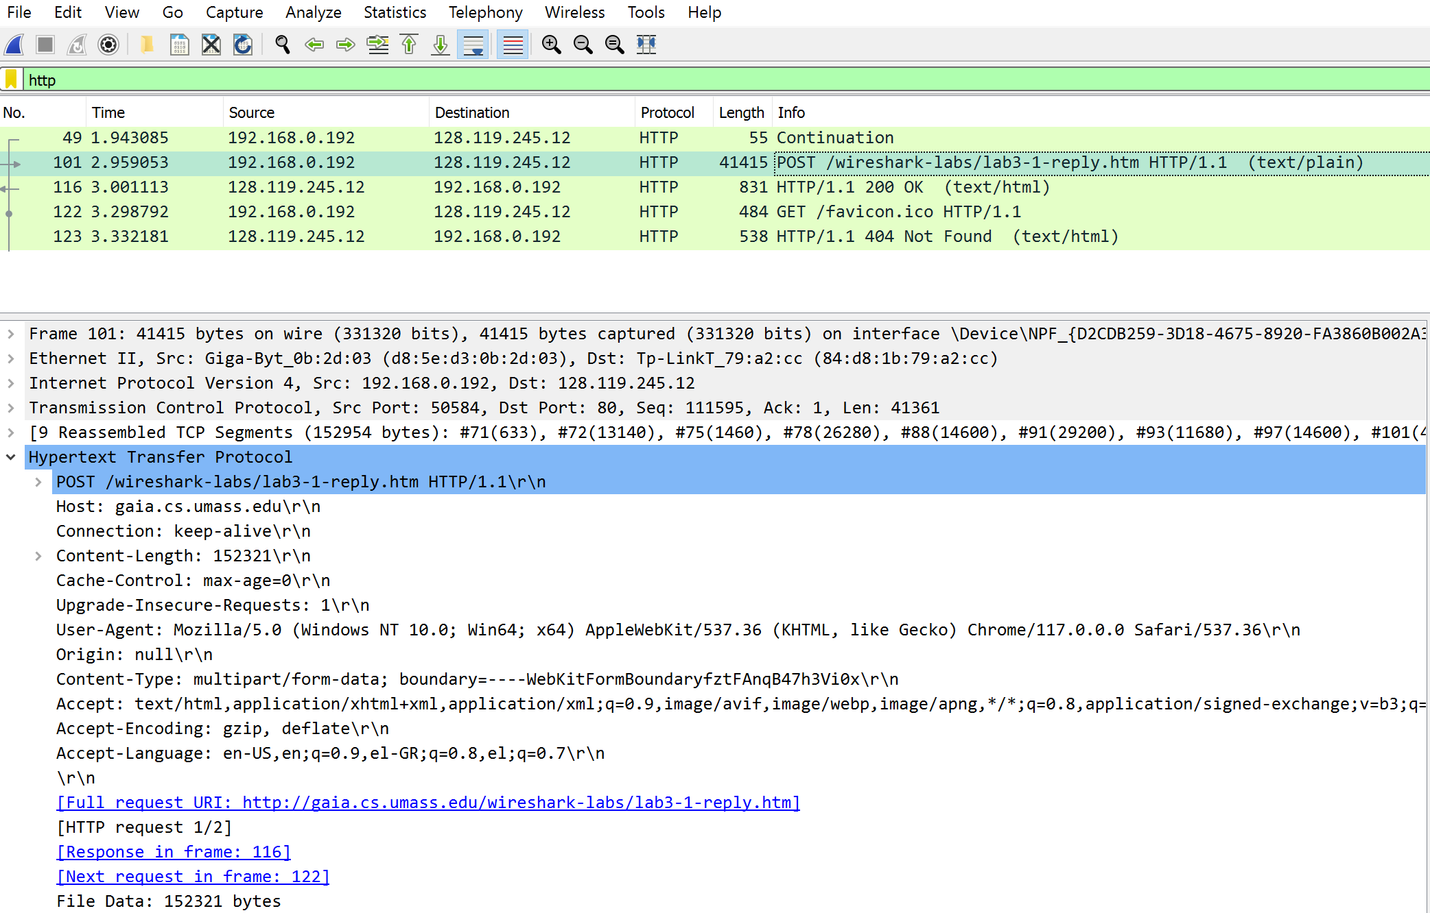

Slide 20
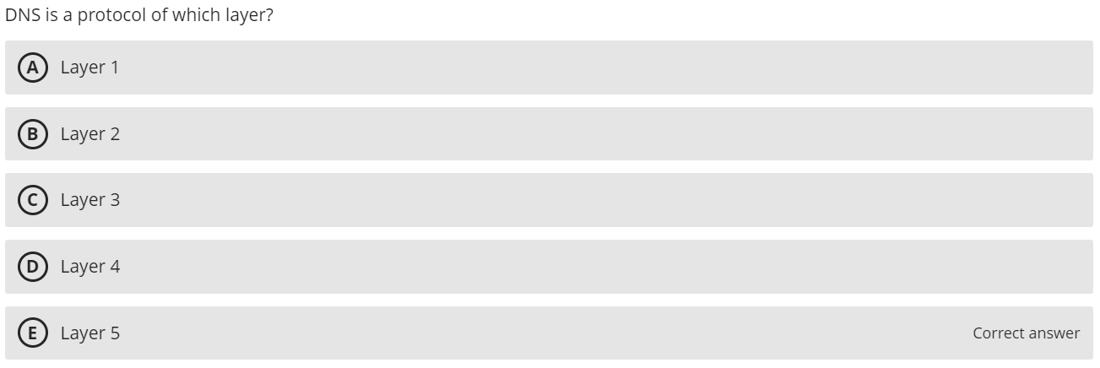
69.73% Correct

Slide 22
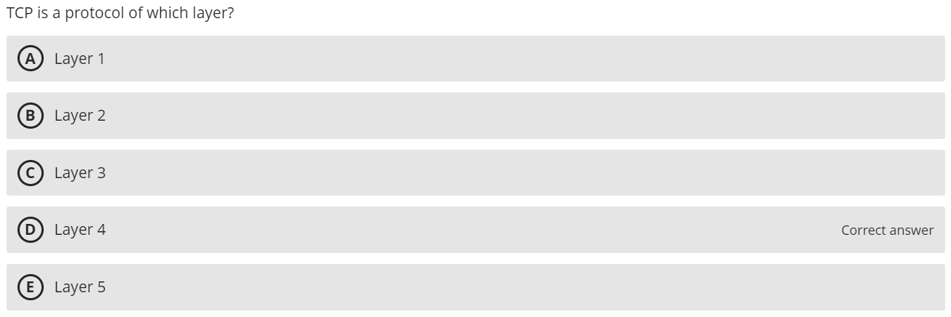
79.82% Correct

Slide 23
L4, L3, L2 Headers
Layer 4
Transport Layer
TCP
Port Numbers
Layer 3
Network Layer
IP
IP Addresses
Layer 2
Data Link Layer
Ethernet
MAC Addresses
Notes:
Source: NetworkLessons.com

Slide 25
 | Sender | PDU | Receiver
Application |  | Packet
Transport |  | Segment
Network |  | Packet
Data Link |  | Frame
Physical
HTTP
HTTP
Request
Request
TCP
TCP
TCP
HTTP
HTTP
HTTP
Request
Request
Request
IP
IP
IP
TCP
TCP
HTTP
HTTP
Request
Request
Ethernet
Ethernet
Ethernet
IP
IP
TCP
TCP
HTTP
HTTP
Request
Request

Slide 26
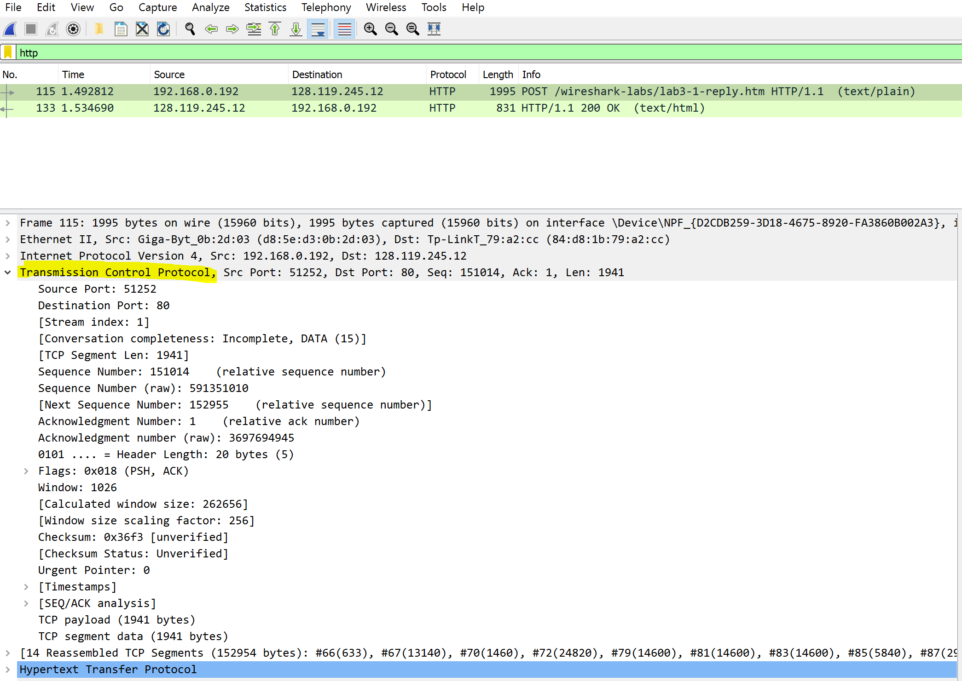

Slide 27
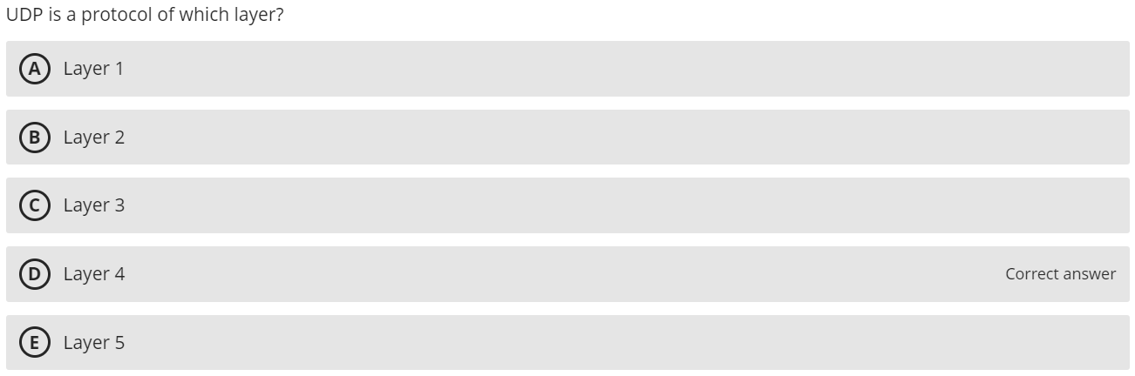
85.57% Correct

Slide 29
Transport Layer Protocols
User Datagram Protocol (UDP)
Operates at the transport layer
PDU called a datagram
Used in time-sensitive situations, for control messages, or when reliability is handled by the application layer
32-64 bits (4-8 bytes) of overhead
Source port is optional in IPv4 and IPv6, Checksum is optional in IPv4
Source Port
(16 bits)
Destination Port
(16 bits)
Length
(16 bits)
Checksum
(16 bits)
User Data
(varies)

Slide 30
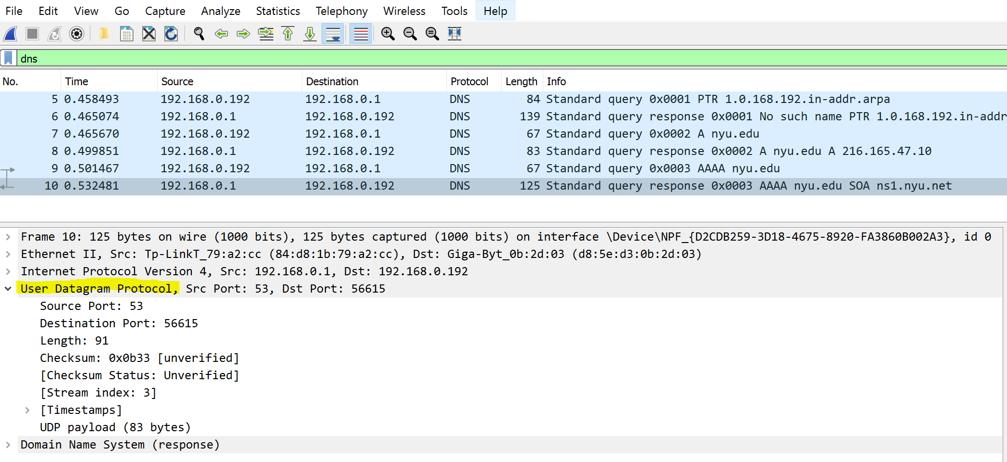
Labs 3 and 5

Slide 31
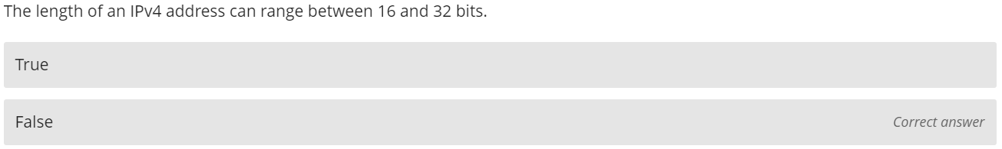
62.58% Correct

Slide 32
Network Layer Functions
Addressing
IPv4 addresses are 32 bits
Most common way to write is using dot-decimal notation
Easier for people to read and remember
Breaks the address into four bytes and writes each byte in decimal notation instead of binary
Example: 129.79.78.193
10000001
01001111
01001110
11000001

Slide 33
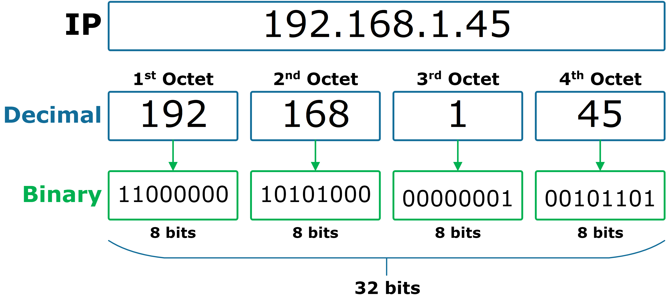
IPv4 Exhaustion
The Internet Corporation for Assigned Names and Numbers (ICANN) is the entity that creates and distributes all IP addresses
2³² = 4,294,967,296 unique IP addresses
We have more devices than that
Notes:
Similar to ASCII with 8 bits and UTF16 with 16 bits
Apple owns almost 18 million IPv4 addresses
The US owns about 37% of all IPv4 addresses
We use NAT to map external addresses to private addresses
The number of IPv4 are still not enough

Slide 34
Network Protocols
IPv4 Packet
160-192 bits (20-24 bytes) of overhead
Options field rarely used
Version number
(4 bits)
Header length
(4 bits)
Type of service
(8 bits)
Total length
(16 bits)
IDs
(16 bits)
Flags
(3 bits)
Packet Offset
(13 bits)
Time to Live /
Hop Limit
(8 bits)
Protocol
(8 bits)
CRC-16
(16 bits)
Source Address
(32 bits)
Destination Address
(32 bits)
Options
(32 bits)
User Data
(varies)

Slide 35
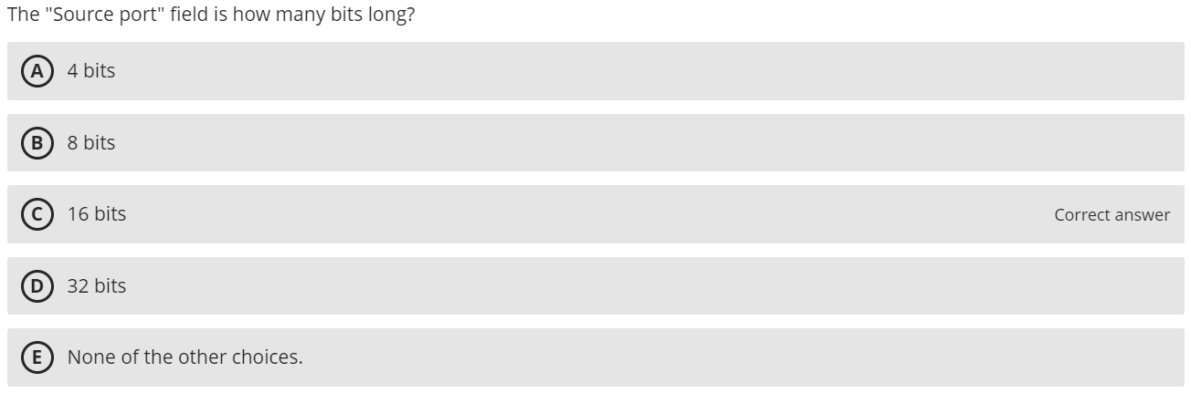
45.5% Correct

Slide 36
Transport Layer Protocols
User Datagram Protocol (UDP)
Operates at the transport layer
PDU called a datagram
Used in time-sensitive situations, for control messages, or when reliability is handled by the application layer
32-64 bits (4-8 bytes) of overhead
Source port is optional in IPv4 and IPv6, Checksum is optional in IPv4
Source Port
(16 bits)
Destination Port
(16 bits)
Length
(16 bits)
Checksum
(16 bits)
User Data
(varies)

Slide 37
Lab 5

Slide 38
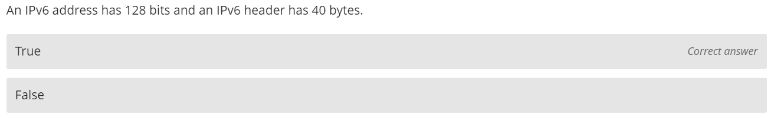
83.55% Correct

Slide 39
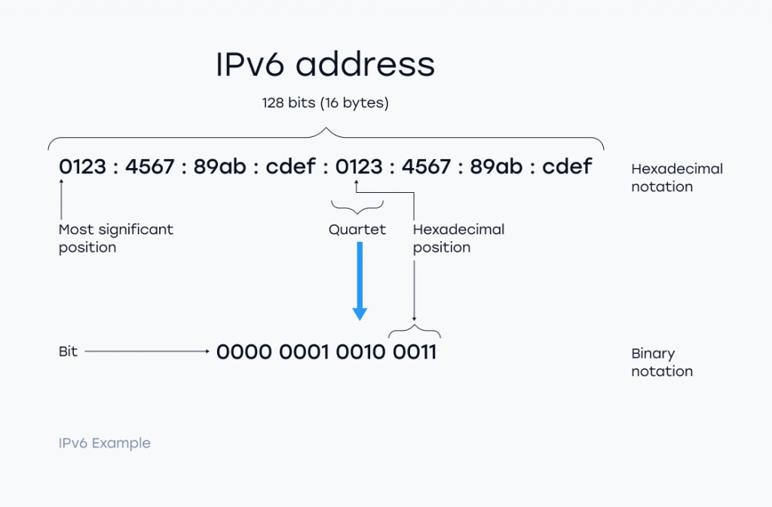
The solution: IPv6
Notes:
Source: vasexperts.com

Slide 40
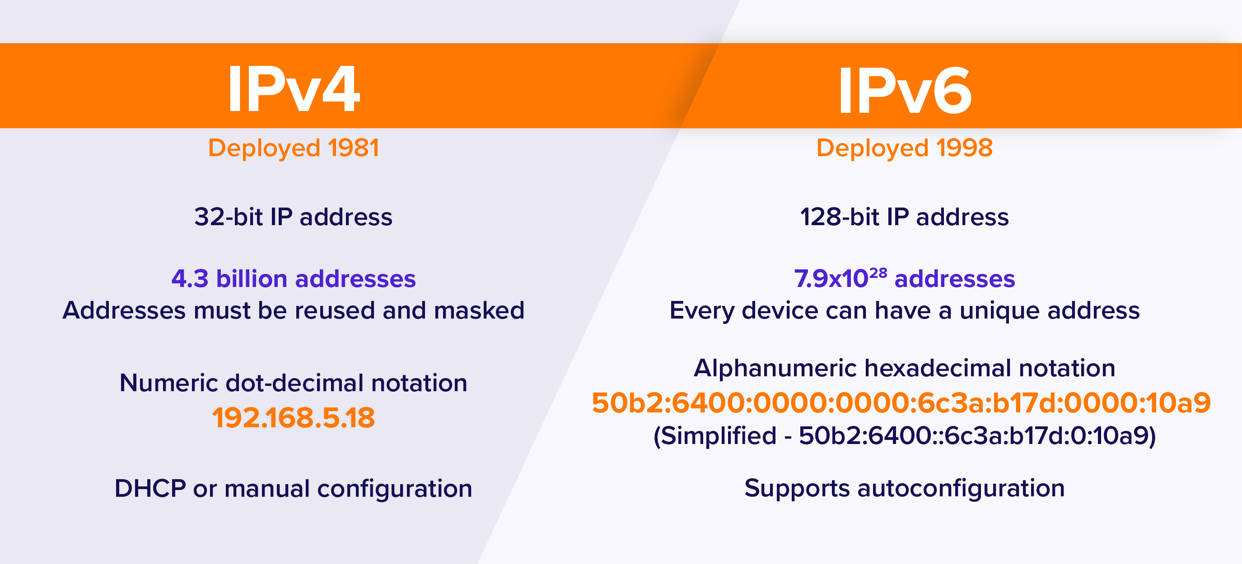
IPv4 vs IPv6

Slide 41
Network Protocols
Optional Headers
IPv6 Packet
Fixed Header
320 bits (40 bytes) of overhead
Version number
(4 bits)
Traffic Class / Priority
(8 bits)
Flow Label
(20 bits)
Payload length
(16 bits)
Next Header
(8 bits)
Hop Limit
(8 bits)
Source Address
(128 bits)
Destination Address
(128 bits)
User Data
(varies)
Optional Headers
Hop-by hop options
Destination options (with routing options)
Routing
Fragment
Authentication
Encapsulation Security Payload
Destination options
Mobility

Slide 42
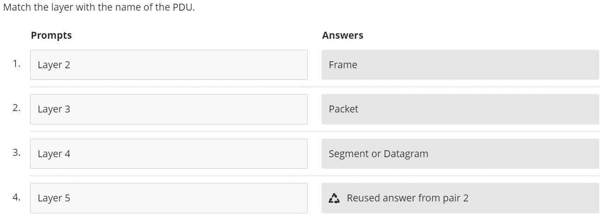
74.46% Correct

Slide 44
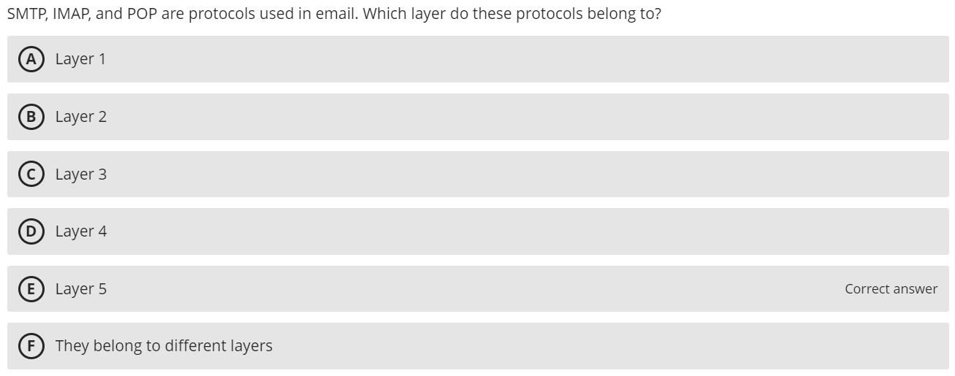
76.87% Correct

Slide 46
Email
Mail User Agent (email client)
Application Layer software package run by client computer
e.g., Outlook, Apple Mail, Thunderbird
Simple Mail Transfer Protocol (SMTP)
Email client formats user email message into this protocol packet
Includes sender address and destination address
Mail Transfer Agent (mail server software)
Application layer software package e.g., Microsoft Exchange
No interaction with user, MTAs transfer to other MTAs until destination is reached
IMAP and POP
Protocols used for communication between email client and mail server
SMTP covers message transmission between email client and mail servers

Slide 47
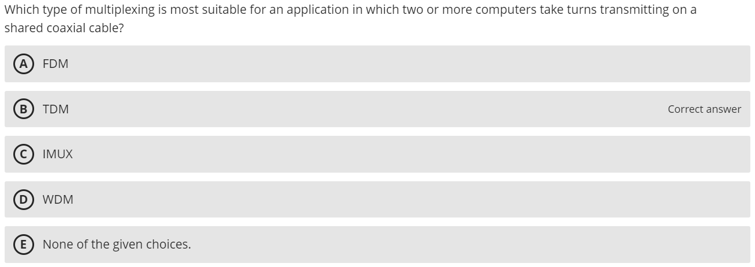
59.63% Correct

Slide 48
Five Types of Multiplexing
Frequency Division Multiplexing (FDM)
Time Division Multiplexing (TDM)
Statistical Time Division Multiplexing (STDM)
Wavelength Division Multiplexing (WDM)
Inverse Multiplexing (IMUX)

Slide 49
Multiplexing
FDM
IMUX
Circuit is divided into a series of separate channels, each transmitting on a different frequency (which prevents interference)
TDM
Two or more computers take turns on the shared circuit (time)
Multiplexing uses 1 high-speed circuit to transmit a set of several low-speed circuits
IMUX does the opposite
Combines several low-speed circuits to make them appear as 1 high-speed circuit to the user

Slide 50

Multiplexing
STDM
WDM
Statistical: assumes only 2 computers will transmit at any time
e.g., users pause to read the screen
Selection of transmission speed for multiplexed circuit is based on statistical analysis of usage of circuits to be multiplexed
Version of FDM used in fiber optic cables
Light has different frequencies (colors)
Instead of using just one color, send multiple through same fiber cable
Increases the capacity of existing fiber optic cable

Slide 51
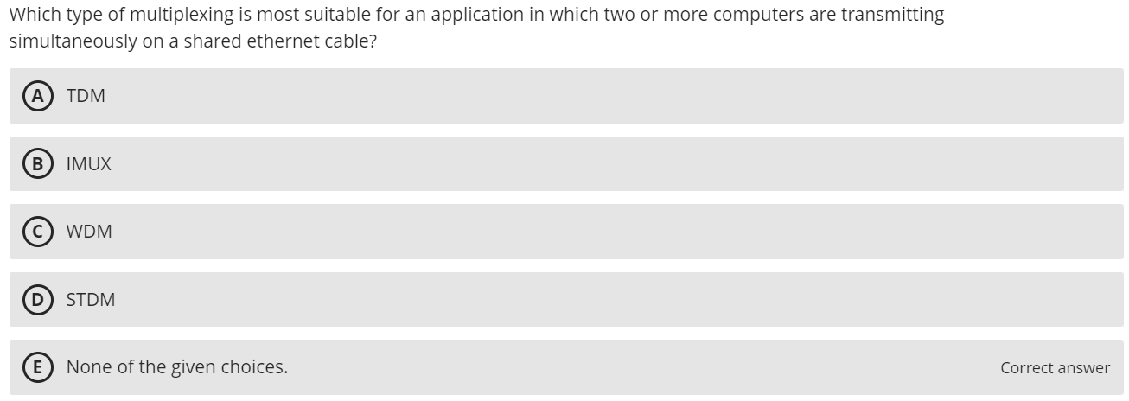
18.02% Correct

Slide 52
Five Types of Multiplexing
Frequency Division Multiplexing (FDM)
Time Division Multiplexing (TDM)
Statistical Time Division Multiplexing (STDM)
Wavelength Division Multiplexing (WDM)
Inverse Multiplexing (IMUX)

Slide 53
Multiplexing
FDM
IMUX
Circuit is divided into a series of separate channels, each transmitting on a different frequency (which prevents interference)
TDM
Two or more computers take turns on the shared circuit (time)
Multiplexing uses 1 high-speed circuit to transmit a set of several low-speed circuits
IMUX does the opposite
Combines several low-speed circuits to make them appear as 1 high-speed circuit to the user

Slide 54
Multiplexing
STDM
WDM
Statistical: assumes only 2 computers will transmit at any time
e.g., users pause to read the screen
Selection of transmission speed for multiplexed circuit is based on statistical analysis of usage of circuits to be multiplexed
Version of FDM used in fiber optic cables
Light has different frequencies (colors)
Instead of using just one color, send multiple through same fiber cable
Increases the capacity of existing fiber optic cable

Slide 55
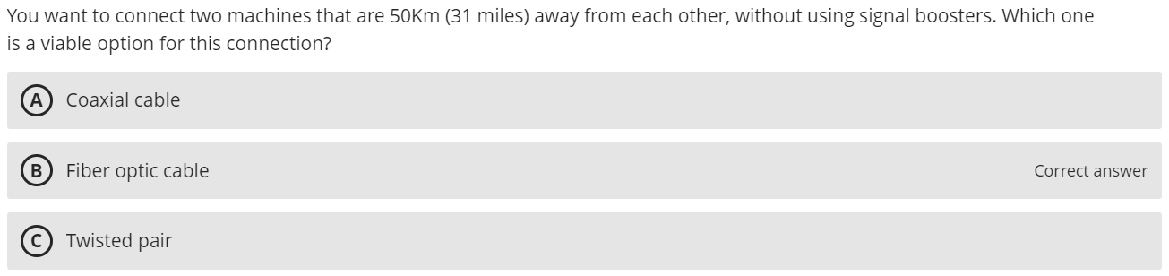
58.39% Correct

Slide 56
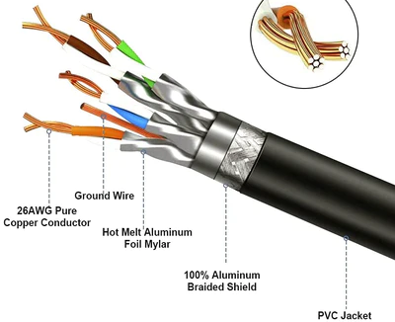
Guided Media
Twisted-pair (TP) cable
Insulated pairs of wires bundled together
Wires twisted to reduce electromagnetic interference
Because they run perpendicular at points
Sometimes use additional shielding
Used for telephones, LANs
Distance up to 100 meters
Inexpensive
Notes:
License: Public Domain
URL: http://commons.wikimedia.org/wiki/File:UTP_cable.jpg
Author: Baran Ivo

Slide 57
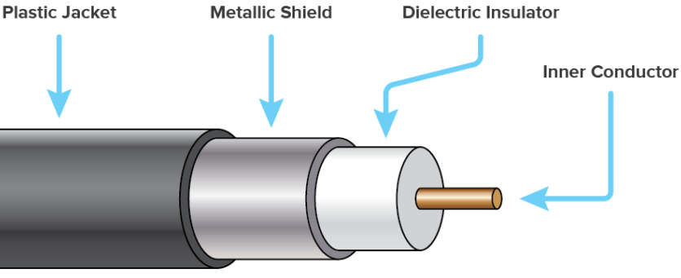
Guided Media
Coaxial cable
Has a single copper core, plus outer insulation, shielding, and inner insulation
Less prone to interference
Inexpensive but more than TP
Distance up to 2 km (1.2 miles)
Used for Cable TV / Internet

Slide 58
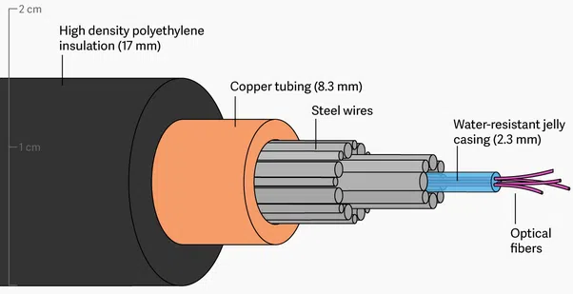
Guided Media
Fiber optic cable
Optical core made of glass or plastic
Data transmitted using light from lasers or LEDs
Resistant to interference and corrosion
Extremely fast data rates
Expensive
Distance of 500m – 100km
Used for Backbone, long distance circuits (e.g., undersea cables)
Notes:
License: CC By
URL: http://commons.wikimedia.org/wiki/File:MultimodeFiber.JPG
Author: Hhedeshian

Slide 59
Wireless Media
Radio Transmission
Wireless transmission of electromagnetic waves through air
Each device on network has a radio transceiver operating at a specific frequency range
Enables mobile network communication
Your laptop uses this for wireless connection
Distance depends on frequency and power
Notes:
What are some well-known frequencies?

Slide 60
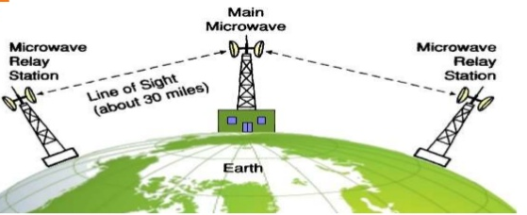
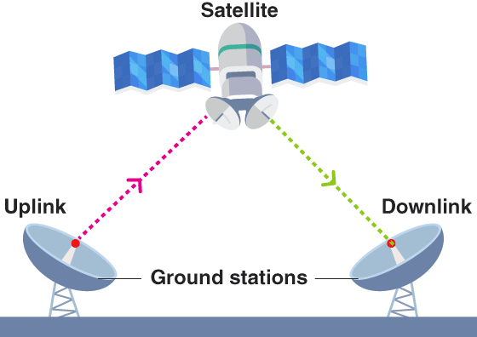
Wireless Media
Microwave
High-frequency radio communication
Line of sight which may require large antennas and towers
Affected by weather
Distance: ~60 km (due to curvature of the earth)
Satellite
Special form of microwave communication involving satellites in space
Long distance leads to propagation delays
Notes:
What do we use for intercontinental communication, cable (wired) or satellite (wireless)?

Slide 61
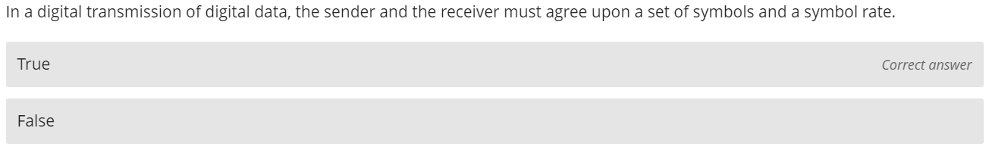
81.22% Correct

Slide 62
Digital Transmission of Digital Data
Sender and receiver must agree upon:
Set of symbols
How bits are encoded as voltages or light pulses
How to distinguish between 0 and 1 bits
Symbol rate
How often symbols are sent

Slide 63
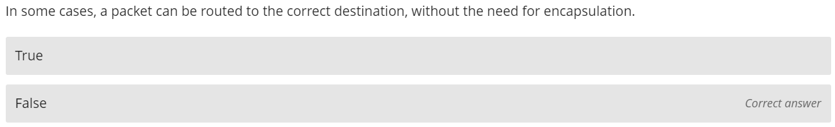
66.15% Correct

Slide 64
L4, L3, L2 Headers
Layer 4
Transport Layer
TCP
Port Numbers
Layer 3
Network Layer
IP
IP Addresses
Layer 2
Data Link Layer
Ethernet
MAC Addresses
Notes:
Source: NetworkLessons.com

Slide 65
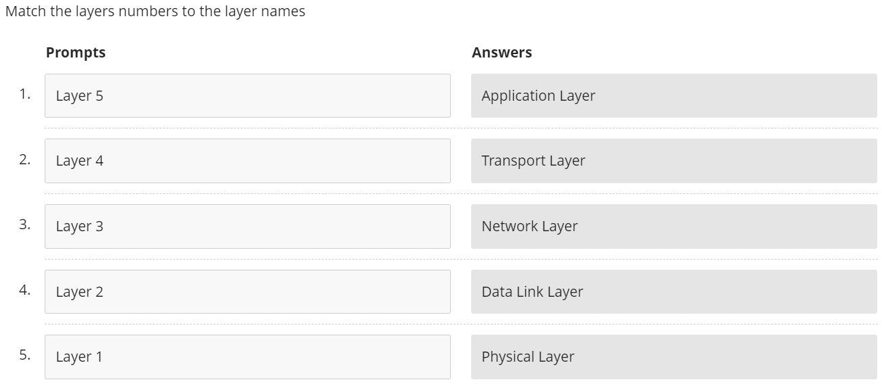
94.54% Correct

Slide 67
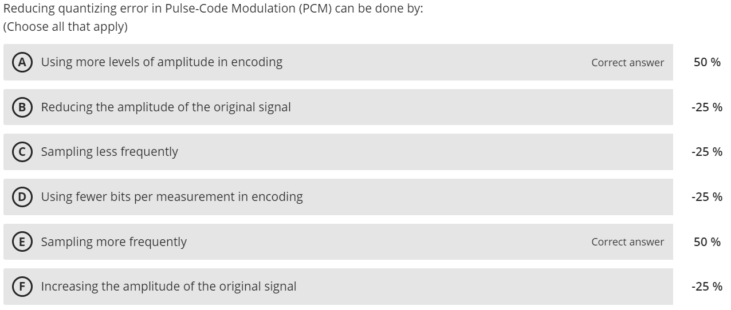
61.31% Correct

Slide 68
Digital Transmission of Analog Data
Pulse-Code Modulation (PCM) converts analog to digital by:
Sampling the analog signal at regular intervals
Measuring the amplitude of each sample
Encoding (quantizing) the amplitude as binary data
Reducing quantizing error can be done by:
Sampling more frequently
Using more levels of amplitude in encoding

Slide 69
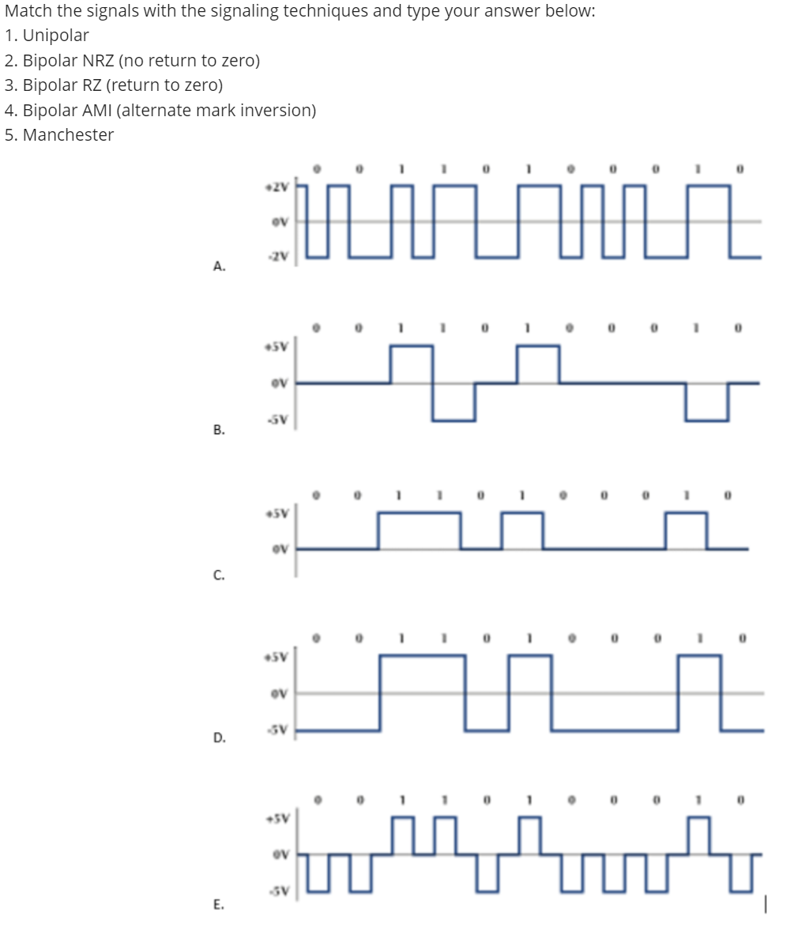
67.15% Correct

Slide 70
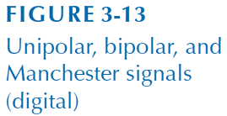
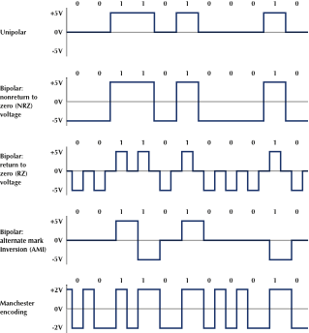
Digital Transmission of Digital Data
Five types of signaling techniques
Unipolar
no current = 0
+5 volts = 1

Slide 71
Digital Transmission of Digital Data
Five types of signaling techniques
Bipolar NRZ (no return to zero)
voltage is positive or negative, but not zero
+5V = 1
-5V = 0

Slide 72
Digital Transmission of Digital Data
Five types of signaling techniques
Bipolar RZ (return to zero)
always returns to 0 after each bit
-5V = 0
+5V = 1
Fewer synchronization errors

Slide 73
Digital Transmission of Digital Data
Five types of signaling techniques
Bipolar AMI (alternate mark inversion)
No volt = 0
1 alternates between +5V and -5V
Double current signaling

Slide 74
Digital Transmission of Digital Data
Five types of signaling techniques
Manchester
Binary phase shift keying (BPSK)
voltage is positive or negative
bits are indicated by a mid-bit transition
Notes:
Ethernet uses this encoding

Slide 75
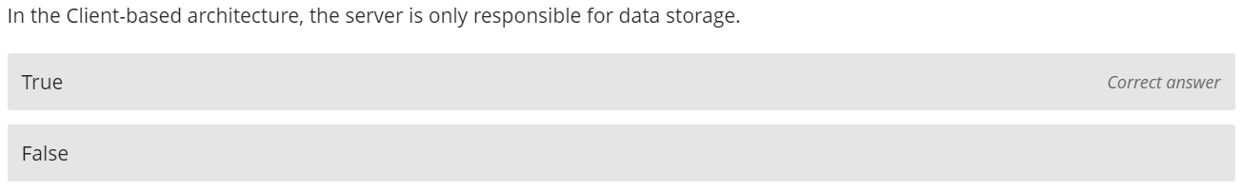
86.96% Correct

Slide 76


Client-Based Architecture
Client contains presentation, application, and data access logic
Most common in the 1980s
CLIENT
SERVER
Presentation Logic
Application Logic
Data Access Logic
Data Storage

Slide 77
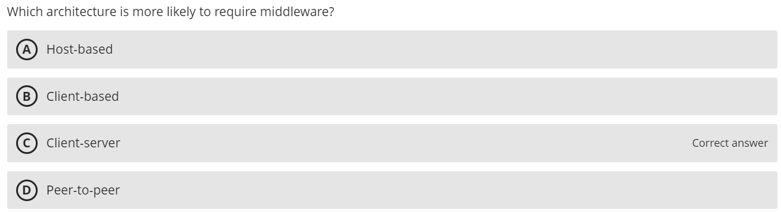
56.84% Correct

Slide 78
Client-Server Architecture
Advantages
More efficient because of distributed processing
Allows hardware/software from different vendors to be used together
Less bandwidth required
Disadvantages
May be challenges in configuring hardware/software from different vendors to work together
In many cases, middleware is required

Slide 79
Client-Server Architecture
Middleware is software that sits between the application software on the client and the application layer on the server
Translates for software from different vendors, allowing communication
Traffic cop: manages message transfers between clients and servers which reduces the amount of processing required for client and server

Slide 80
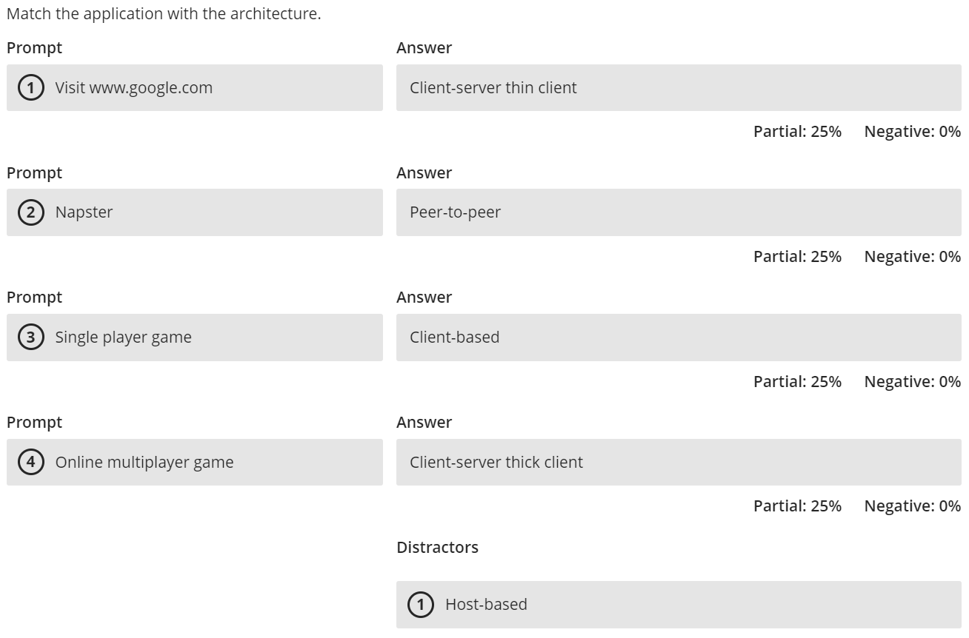
69.92% Correct

Slide 81
Which Architecture Is It?
Youtube
ChatGPT
Visiting a news website
BitTorrent
Online multiplayer game
Single player game
Notes:
Youtube – Client/Server, thin client
ChatGPT – Host based
Visiting a news website - Client/Server, thin client
BitTorrent – Peer to peer
Online multiplayer game - Client/Server, thick client
Single player game – Client based

Slide 82
Peer-to-Peer Architecture
An older architecture that became popular again with Napster, BitTorrent, etc.
All devices can act as client and server
CLIENT/SERVER
CLIENT/SERVER
Presentation Logic
Application Logic
Data Access Logic
Data Storage
Presentation Logic
Application Logic
Data Access Logic
Data Storage

Slide 83
72.68% Correct

Slide 84
Transport Layer Functions
Linking to the application layer
TCP/UDP may serve multiple application layer protocols
Ports used to identify application (2-byte numbers)
Many source/destination ports follow standards
Common port standards
HTTP: TCP port 80
HTTPS: TCP port 443
FTP: TCP ports 20 and 21
SMTP: TCP port 25
IMAP: TCP port 143
POP3: TCP port 110 or port 995 (secure version)
DNS: TCP or UDP port 53 (most commonly UDP)

Slide 85




Slide 86
Lab 4 question 2

Slide 87
56.06% Correct

Slide 88
Transport Layer Functions
Linking to the application layer
TCP/UDP may serve multiple application layer protocols
Ports used to identify application (2-byte numbers)
Many source/destination ports follow standards
Common port standards
HTTP: TCP port 80
HTTPS: TCP port 443
FTP: TCP ports 20 and 21
SMTP: TCP port 25
IMAP: TCP port 143
POP3: TCP port 110 or port 995 (secure version)
DNS: TCP or UDP port 53 (most commonly UDP)

Slide 89


Slide 90
82.11% Correct

Slide 91
Transport Layer Functions
Session management
A session can be thought of as a conversation between two computers or creating a virtual circuit
Using a session to send data is also called connection-oriented messaging (TCP)
Sending messages without establishing a session is connectionless messaging (UDP)
TCP connections are opened using a three-way handshake
SYN
SYN-ACK
ACK
Sessions provide reliable end-to-end connections

Slide 92
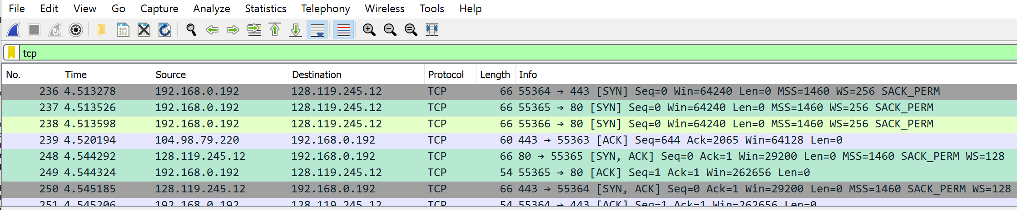
Lab 4

Slide 93
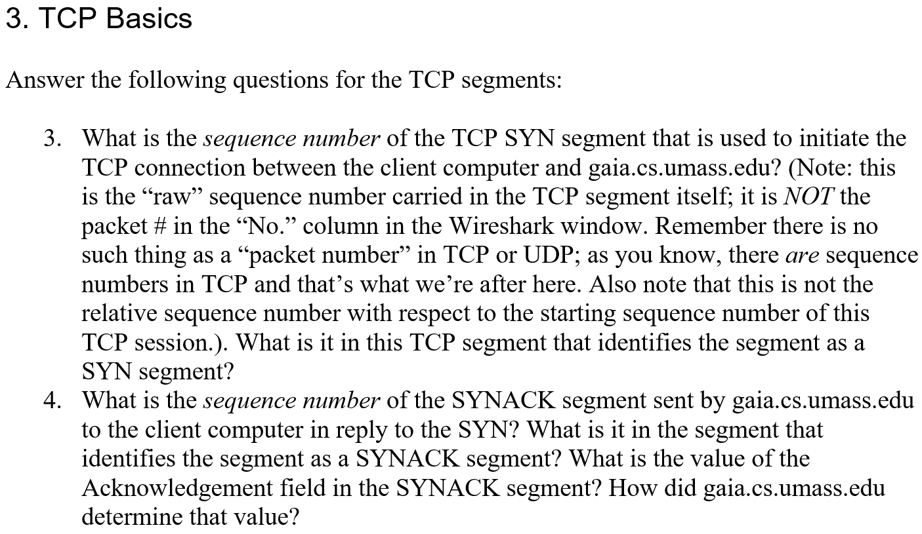
Lab 4 questions 3 and 4

Slide 94
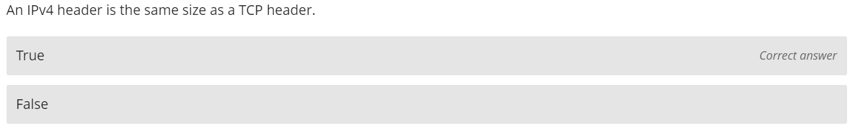
64.76% Correct

Slide 95
Transport Layer Protocols
Transmission Control Protocol (TCP)
Most common transport layer protocol
PDU called a segment
Used for reliable transmission of data
160 - 192 bits (20-24 bytes) of overhead
Options field is not required
Source Port
(16 bits)
Destination Port
(16 bits)
Sequence Number
(32 bits)
ACK number
(32 bits)
Header Length
(4 bits)
Unused
(6 bits)
Flags
(6 bits)
Flow Control
(16 bits)
CRC-16
(16 bits)
Urgent Pointer
(16 bits)
Options
(32 bits)
User Data
(varies)

Slide 96
Network Protocols
IPv4 Packet
160-192 bits (20-24 bytes) of overhead
Options field rarely used
Version number
(4 bits)
Header length
(4 bits)
Type of service
(8 bits)
Total length
(16 bits)
IDs
(16 bits)
Flags
(3 bits)
Packet Offset
(13 bits)
Time to Live /
Hop Limit
(8 bits)
Protocol
(8 bits)
CRC-16
(16 bits)
Source Address
(32 bits)
Destination Address
(32 bits)
Options
(32 bits)
User Data
(varies)

Slide 97
Transport Layer Functions
Segmenting
Breaking up large files into smaller segments (and putting them back together)
Segments may be passed individually to application layer or after reassembly
How large are the segments?
Size depends on the network and data link layer protocols
Maximum Segment Size (MSS) is negotiated during TCP handshake
e.g., if the maximum size of the data in an Ethernet frame is 1,500 bytes and TCP and IP use 20 byte headers, the maximum segment size is 1460 bytes
IPv4 header
Ethernet Frame Data Size
1500 – 20 – 20 = 1460 bytes
TCP header

Slide 98
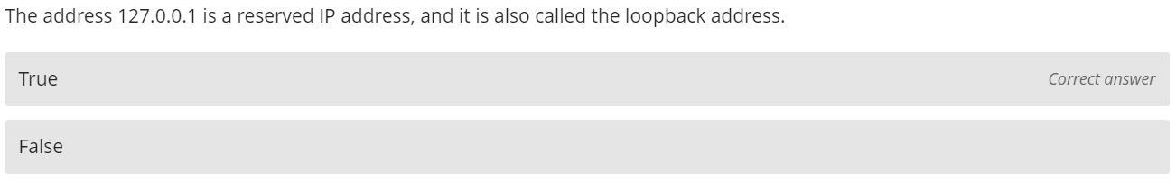
92.86% Correct

Slide 99
Reserved IP Addresses
Certain IP addresses within each class are reserved for special purposes:
Class A: 0.0.0.0 (default route) and 127.0.0.1 (loopback).
Class B: 169.254.0.0 to 169.254.255.255 (APIPA).
Class C: 192.168.0.0 to 192.168.255.255 (Private IP addresses).
A default route is the route that takes effect when no other route is available for an IP destination address.
Any traffic that a computer program sends on the loopback network is addressed to the same computer.
APIPA (Automatic Private IP Addressing) is a feature in operating systems like Windows that allows computers to automatically configure an IP address and subnet mask when their DHCP server is unavailable.
Private IP addresses are reserved for home use.

Slide 100
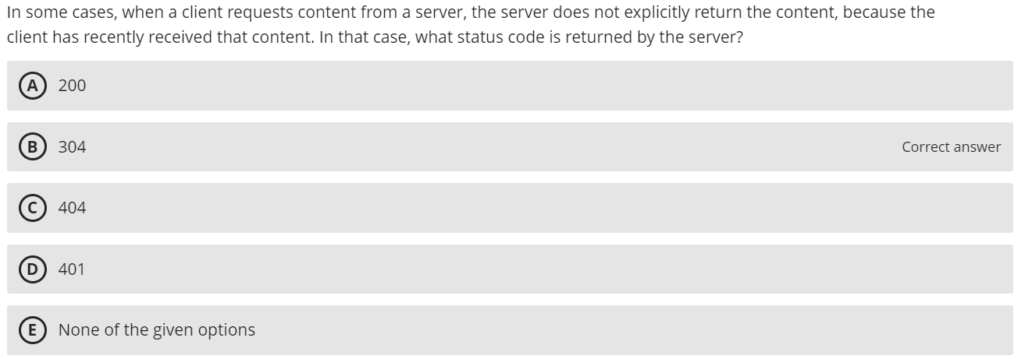
42.4% Correct

Slide 101

Lab 2 section 3

Slide 102

93.48% Correct

Slide 103
Reserved IP Addresses
Certain IP addresses within each class are reserved for special purposes:
Class A: 0.0.0.0 (default route) and 127.0.0.1 (loopback).
Class B: 169.254.0.0 to 169.254.255.255 (APIPA).
Class C: 192.168.0.0 to 192.168.255.255 (Private IP addresses).
A default route is the route that takes effect when no other route is available for an IP destination address.
Any traffic that a computer program sends on the loopback network is addressed to the same computer.
APIPA (Automatic Private IP Addressing) is a feature in operating systems like Windows that allows computers to automatically configure an IP address and subnet mask when their DHCP server is unavailable.
Private IP addresses are reserved for home use.

Slide 104

46.74% Correct

Slide 105
Transport Layer Functions
Linking to the application layer
TCP/UDP may serve multiple application layer protocols
Ports used to identify application (2-byte numbers)
Many source/destination ports follow standards
Common port standards
HTTP: TCP port 80
HTTPS: TCP port 443
FTP: TCP ports 20 and 21
SMTP: TCP port 25
IMAP: TCP port 143
POP3: TCP port 110 or port 995 (secure version)
DNS: TCP or UDP port 53 (most commonly UDP)

Slide 106

60.41% Correct

Slide 107

Public IP and Private IP

Slide 108

95.66% Correct

Slide 109
Lab 4 questions 3 and 4

Slide 110
Lab 4

Slide 111

71.28% Correct

Slide 112
Transport Layer Functions
Linking to the application layer
TCP/UDP may serve multiple application layer protocols
Ports used to identify application (2-byte numbers)
Many source/destination ports follow standards
Common port standards
HTTP: TCP port 80
HTTPS: TCP port 443
FTP: TCP ports 20 and 21
SMTP: TCP port 25
IMAP: TCP port 143
POP3: TCP port 110 or port 995 (secure version)
DNS: TCP or UDP port 53 (most commonly UDP)

Slide 114

89.91% Correct

Slide 115
L4, L3, L2 Headers
Layer 4
Transport Layer
TCP
Port Numbers
Layer 3
Network Layer
IP
IP Addresses
Layer 2
Data Link Layer
Ethernet
MAC Addresses
Notes:
Source: NetworkLessons.com

Slide 117

63.98% Correct

Slide 118
Encapsulation and Headers
L2 Frame – Gets converted to binary
L2 Frame’s Data Field – L3 Packet
L3 Packet’s Data Field – L4 Segment
L4 Segment’s Data Field – L5 Packet
[HTTP [HTML [“Congratulations! You’ve…”]]]

Slide 119

91.31% Correct

Slide 120
Network Models
Advantages of Layers
Networking functionality is modular and the software/hardware at any layer can be more easily substituted
E.g., substitute wired for wireless at the physical layer
Easier to troubleshoot or make changes to one layer at a time
Application developers only need to worry about the application layer in their programs
Disadvantages of Layers
Inefficient because the encapsulation/de-encapsulation at each layer requires processing
Inefficient because encapsulation in a PDU increases overhead at each layer
Notes:
Packets become larger

Slide 121

91.31% Correct

Slide 122
Network Models
Advantages of Layers
Networking functionality is modular and the software/hardware at any layer can be more easily substituted
E.g., substitute wired for wireless at the physical layer
Easier to troubleshoot or make changes to one layer at a time
Application developers only need to worry about the application layer in their programs
Disadvantages of Layers
Inefficient because the encapsulation/de-encapsulation at each layer requires processing
Inefficient because encapsulation in a PDU increases overhead at each layer
Notes:
Packets become larger

Slide 123

79.82% Correct

Slide 124
Network Models
Advantages of Layers
Networking functionality is modular and the software/hardware at any layer can be more easily substituted
E.g., substitute wired for wireless at the physical layer
Easier to troubleshoot or make changes to one layer at a time
Application developers only need to worry about the application layer in their programs
Disadvantages of Layers
Inefficient because the encapsulation/de-encapsulation at each layer requires processing
Inefficient because encapsulation in a PDU increases overhead at each layer
Notes:
Packets become larger

Slide 125

67.56% Correct

Slide 126

Host-Based Architecture
Server contains all components (“server-based”)
Common in the 1960s with mainframes and terminals
CLIENT
SERVER
Presentation Logic
Application Logic
Data Access Logic
Data Storage

Slide 127

89.91% Correct

Slide 128
Transport Layer Functions

Slide 129

94.26% Correct

Slide 130


Digital vs. Analog Data
Digital transmission involves discrete binary values (i.e., 0 or 1)
Analog transmission involves continuous waves

Slide 131

73.69% Correct

Slide 132

Source Port
(16 bits)
Destination Port
(16 bits)
Sequence Number
(32 bits)
ACK number
(32 bits)
Header Length
(4 bits)
Unused
(6 bits)
Flags
(6 bits)
Flow Control
(16 bits)
CRC-16
(16 bits)
Urgent Pointer
(16 bits)
Options
(32 bits)
User Data
(varies)

Slide 133

73.3% Correct

Slide 134
Transport Layer Protocols
User Datagram Protocol (UDP)
Operates at the transport layer
PDU called a datagram
Used in time-sensitive situations, for control messages, or when reliability is handled by the application layer
32-64 bits (4-8 bytes) of overhead
Source port is optional in IPv4 and IPv6, Checksum is optional in IPv4
Source Port
(16 bits)
Destination Port
(16 bits)
Length
(16 bits)
Checksum
(16 bits)
User Data
(varies)

Slide 135

94.26% Correct

Slide 136
Network Layer Functions
Dynamic addressing
Configuring each device manually is time consuming
Assigning addresses permanently can be inefficient when devices are not connected to network
A server can be designated to supply IP addresses automatically
Dynamic Host Configuration Protocol (DHCP)
Most common protocol for dynamic addressing
Device (e.g., laptop) sends out broadcast message requesting an IP address
DHCP server responds with assigned network layer address and its subnet mask
Addresses are “leased” for a length of time from a list of authorized addresses

Slide 137
MAC Address
MAC stands for Media Access Control
Also known as Physical Address
Unique 12-digit hexadecimal number that identifies a device on a network
Looks like this: 00-B0-D0-63-C2-26
Each device has a unique MAC address
Decided during manufacturing and hard-coded on the chip

Slide 138
15.15% Correct

Slide 139


Lab 3

Slide 140

100% Correct

Slide 141
Types of Routing
Centralized Routing
Routing decisions made by one computer
All computers are connected to this one computer
Decentralized Routing
Decisions made by each node independently of one another
Information needs to be exchanged to prepare routing tables

Slide 142

61.81% Correct

Slide 143
Decentralized Routing
Static
All computers make their own routing decisions
Routing table manually configured by network managers in MANs and WANs
One individual or committee develops for LANs and Backbone networks
Local adjustments when computers added or removed
Dynamic
Routing decisions made by individual computers
Routing tables updated periodically
Routers exchange information using protocols to update tables
Used when there are multiple routes through a network

Slide 144

93.87% Correct

Slide 145


Slide 146

79.82% Correct

Slide 147
Routing
Dynamic routing algorithms
Distance vector: routers count the number of “hops” along a route
Computers periodically exchange information about hop count, speed of the circuits in the route, and how busy they are
Link state: computers or routers track the number of hops, circuit speed, and traffic congestion
Opposed to just knowing the distance, determines how fast each possible route is
Provides more reliable, up to date paths to destinations

Slide 148

27.14% Correct

Slide 149
Routing Protocols
Routing Information Protocol (RIP)
Dynamic distance vector protocol used in smaller networks
Operation
Network manager builds the routing table
Routing tables broadcast periodically
When new computers are added, router counts “hops” and selects the shortest route

Slide 150
Routing Protocols
Open Shortest Path First (OSPF)
Dynamic hybrid interior routing protocol
Commonly used on the internet and large enterprise networks
More reliable paths less burdensome to the network because only updates sent
Uses the number of computers on the route, network traffic, and error rates to select the best route

Slide 151
Routing Protocols
Enhanced Interior Gateway Routing Protocol (EIGRP)
A dynamic hybrid interior routing protocol (developed by Cisco)
Hybrid because some features act like distance vector and others like link-state protocols
Commonly used inside organizations
Records transmission capacity, delay time, reliability and load for all paths
Keeps the routing tables for its neighbors and uses this information in its routing decisions as well

Slide 152
Routing Protocols
If each network uses a different protocol internally, how are they able to communicate?
Border Gateway Protocol (BGP)
Dynamic distance vector protocol used for exterior routing
Far more complex than interior routing protocols so rarely used inside companies; hard to administer
Provide routing info only on selected routes (e.g., preferred or best route)
Used on the internet to exchange routing information between large sections (autonomous systems) of the internet

Slide 153

94.99% Correct

Slide 154
Multicasting (Communication)
Unicast - one computer to another computer
Broadcast - one computer to all computers in the network
Multicast - one computer to a group of computers (e.g., videoconference)
Same data needs to reach multiple receivers and avoid transmitting it once for each receiver
In IP multicast, hosts dynamically join and leave multicast groups using Internet Group Management Protocol (IGMP)
The multicast group is assigned a special IP address
All messages with this IP address routed to onto the subnet that contains requesting computer
If I decide to leave the videoconference, my computer sends an IGMP message to the computer performing routing to remove me from the multicast group.

Slide 155

66.93% Correct

Slide 156
TCP/IP Example
When my computer dials into a TCP/IP network it must be given 4 pieces of info to operate, provided by DHCP server or config file
Device’s own IP address
Subnet mask
IP address of default gateway (most commonly the router)
IP address of at least one DNS server

Slide 157

66.8% Correct

Slide 158
IPv4 Exhaustion
The Internet Corporation for Assigned Names and Numbers (ICANN) is the entity that creates and distributes all IP addresses
2³² = 4,294,967,296 unique IP addresses
We have more devices than that
Notes:
Similar to ASCII with 8 bits and UTF16 with 16 bits
Apple owns almost 18 million IPv4 addresses
The US owns about 37% of all IPv4 addresses
We use NAT to map external addresses to private addresses
The number of IPv4 are still not enough

Slide 159

62.58% Correct

Slide 160
Transport Layer Protocols
User Datagram Protocol (UDP)
Operates at the transport layer
PDU called a datagram
Used in time-sensitive situations, for control messages, or when reliability is handled by the application layer
32-64 bits (4-8 bytes) of overhead
Source port is optional in IPv4 and IPv6, Checksum is optional in IPv4
Source Port
(16 bits)
Destination Port
(16 bits)
Length
(16 bits)
Checksum
(16 bits)
User Data
(varies)

Slide 161

88.44% Correct

Slide 162

Lab 4

Slide 163

23.76% Correct

Slide 164
Network Layer Functions
Dynamic addressing
Configuring each device manually is time consuming
Assigning addresses permanently can be inefficient when devices are not connected to network
A server can be designated to supply IP addresses automatically
Dynamic Host Configuration Protocol (DHCP)
Most common protocol for dynamic addressing
Device (e.g., laptop) sends out broadcast message requesting an IP address
DHCP server responds with assigned network layer address and its subnet mask
Addresses are “leased” for a length of time from a list of authorized addresses

Slide 165
Multicasting (Communication)
Unicast - one computer to another computer
Broadcast - one computer to all computers in the network
Multicast - one computer to a group of computers (e.g., videoconference)
Same data needs to reach multiple receivers and avoid transmitting it once for each receiver
In IP multicast, hosts dynamically join and leave multicast groups using Internet Group Management Protocol (IGMP)
The multicast group is assigned a special IP address
All messages with this IP address routed to onto the subnet that contains requesting computer
If I decide to leave the videoconference, my computer sends an IGMP message to the computer performing routing to remove me from the multicast group.

Slide 166

68.83% Correct

Slide 167
Transport Layer Functions
Session management
A session can be thought of as a conversation between two computers or creating a virtual circuit
Using a session to send data is also called connection-oriented messaging (TCP)
Sending messages without establishing a session is connectionless messaging (UDP)
TCP connections are opened using a three-way handshake
SYN
SYN-ACK
ACK
Sessions provide reliable end-to-end connections

Slide 168

30.91% Correct

Slide 169

Lab 3

Slide 170

85.57% Correct

Slide 171
Example app: UDP client
Python UDPClient
include Python’s socket
library
from socket import *
serverName = ‘hostname’
serverPort = 12000
clientSocket = socket(socket.AF_INET,
socket.SOCK_DGRAM)
message = raw_input(’Input lowercase sentence:’)
clientSocket.sendto(message,(serverName, serverPort))
modifiedMessage, serverAddress =
clientSocket.recvfrom(2048)
print modifiedMessage
clientSocket.close()
create UDP socket for server
get user keyboard
input
Attach server name, port to message; send into socket
read reply characters from
socket into string
print out received string and close socket

Slide 172
Example app: TCP client
Python TCPClient
from socket import *
serverName = ’servername’
serverPort = 12000
clientSocket = socket(AF_INET, SOCK_STREAM)
clientSocket.connect((serverName,serverPort))
sentence = raw_input(‘Input lowercase sentence:’)
clientSocket.send(sentence)
modifiedSentence = clientSocket.recv(1024)
print ‘From Server:’, modifiedSentence
clientSocket.close()
create TCP socket for server, remote port 12000
No need to attach server name, port

Slide 173

86.96% Correct

Slide 174
Socket programming with UDP
UDP: no “connection” between client & server
no handshaking before sending data
sender explicitly attaches IP destination address and port # to each packet
rcvr extracts sender IP address and port# from received packet
UDP: transmitted data may be lost or received out-of-order
Application viewpoint:
UDP provides unreliable transfer of groups of bytes (“datagrams”) between client and server

Slide 175
UDP: User Datagram Protocol [RFC 768]
“no frills,” “bare bones” Internet transport protocol
“best effort” service, UDP segments may be:
lost
delivered out-of-order to app
connectionless:
no handshaking between UDP sender, receiver
each UDP segment handled independently of others
UDP use:
streaming multimedia apps (loss tolerant, rate sensitive)
DNS
SNMP
reliable transfer over UDP:
add reliability at application layer
application-specific error recovery!

Slide 176
TCP: Overview RFCs: 793,1122,1323, 2018, 2581
point-to-point:
one sender, one receiver
reliable, in-order byte steam:
no “message boundaries”
pipelined:
TCP congestion and flow control set window size
full duplex data:
bi-directional data flow in same connection
MSS: maximum segment size
connection-oriented:
handshaking (exchange of control msgs) inits sender, receiver state before data exchange
flow controlled:
sender will not overwhelm receiver

Slide 177

68.33% Correct

Slide 178
Data Link Protocols
Ethernet
Developed into a formal standard, IEEE 802.3ac
Several versions in use today
Uses contention media access control (handles when two computers try to transmit at the same time)
Ethernet II Frame
Interframe Gap
(12 bytes)
Preamble & Delimiter
(8 bytes)
Destination Address
(6 bytes)
Source Address
(6 bytes)
Type
(2 bytes)
Data
(46-1500 bytes)
CRC
(4 bytes)

Slide 179

68.33% Correct

Slide 180
Additional Terminology
Each communication protocol has both:
Information bits – those used to convey the user’s meaning
Overhead bits – used for error checking; used to mark the start and end of characters and packets
Transmission efficiency – determined by dividing the total number of information bits by the total bits in the transmission
Throughput – the total number of information bits received per second after accounting for overhead bits and retransmissions

Slide 181

7.93% Correct

Slide 182
Additional Terminology
Each communication protocol has both:
Information bits – those used to convey the user’s meaning
Overhead bits – used for error checking; used to mark the start and end of characters and packets
Transmission efficiency – determined by dividing the total number of information bits by the total bits in the transmission
Throughput – the total number of information bits received per second after accounting for overhead bits and retransmissions

Slide 183

54.67% Correct

Slide 184
Data Link Protocols
Ethernet
Developed into a formal standard, IEEE 802.3ac
Several versions in use today
Uses contention media access control (handles when two computers try to transmit at the same time)
Ethernet II Frame
Interframe Gap
(12 bytes)
Preamble & Delimiter
(8 bytes)
Destination Address
(6 bytes)
Source Address
(6 bytes)
Type
(2 bytes)
Data
(46-1500 bytes)
CRC
(4 bytes)

Slide 185

69.73% Correct

Slide 186
Network Protocols
IPv4 Packet
160-192 bits (20-24 bytes) of overhead
Options field rarely used
Version number
(4 bits)
Header length
(4 bits)
Type of service
(8 bits)
Total length
(16 bits)
IDs
(16 bits)
Flags
(3 bits)
Packet Offset
(13 bits)
Time to Live /
Hop Limit
(8 bits)
Protocol
(8 bits)
CRC-16
(16 bits)
Source Address
(32 bits)
Destination Address
(32 bits)
Options
(32 bits)
User Data
(varies)

Slide 187
Network Layer Functions
Addressing
IPv4 addresses are 32 bits
Most common way to write is using dot-decimal notation
Easier for people to read and remember
Breaks the address into four bytes and writes each byte in decimal notation instead of binary
Example: 129.79.78.193
10000001
01001111
01001110
11000001

Slide 188

78.43% Correct

Slide 189

83.93% Correct

Slide 190
Media Access Control
Contention
Transmit whenever circuit is available with no centralized control
Common in Ethernet LANs
When devices transmit at the same time, a collision occurs
Devices must be “polite” and follow these steps:
“Listen” for traffic
If another device is transmitting, wait to transmit
Otherwise, transmit (and keep listening)
If another device begins to transmit, stop and wait

Slide 191
Media Access Control
Controlled access
Common in wireless LANs
Controlled by wireless access point
Access Request Technique
Each device must get “permission” to transmit, similar to raising a hand
Polling
Roll-call polling
Central device (controller) determines which devices can transmit
Each client is checked periodically to see if it needs to transmit
Hub Polling (token passing)
One device begins the poll and then passes it to another device until it reaches them all

Slide 192

64.96% Correct

Slide 193
Error Detection
Receivers need to know when the data transmitted is not correct
Add “check value” (error detection value) to message
Check value produced by mathematical formula
Three error detection methods:
Parity checking
Checksum
Cyclic redundancy checking
Message
Check Value

Slide 194
Error Detection
Parity check
1-bit check value
Based on the number of 1’s in the message
Even parity: number of 1’s remains even
Odd parity: number of 1’s remains odd
Simple, but only detects 50% of errors
Example (Even Parity)
Character: ‘A’
Binary: 01000001
Parity Bit: 0
Character: ‘C’
Binary: 01000011
Parity Bit: 1

Slide 195
Error Detection
Checksum
1-byte (typically) check value
Checksum algorithms vary in the creation of check values
Detects 95% of errors

Slide 196
Error Detection
Cyclic redundancy check (CRC)
Treats message as a single binary number
Divides by a preset number
Uses remainder as the check value
Preset number is chosen so that remainder is the correct number of bits
Modes:
CRC-16 (~99.998% error detection rate)
CRC-32 (>99.99999% error detection rate)

Slide 197
Conclusions
Time was not an issue
I might be helping too much with labs
You clearly have questions
Come to office hours
Ask them in class
Email me
Start studying early
Pay attention in class
Highest score 1034 out of 1160
I will be curving the grades by 126 points

